Slide 1


DECODING DIGITAL DECEPTION: A DEEP LEARNING PIPELINE FOR REAL-TIME DEEPFAKE DETECTION
Department of Information Science and Engineering
Team Members
1. Adarsha K A(1OX21IS008)
2.Akash Kashyap K N(1OX21IS012)
3. Baisani Venkata Jaswanth(1OX21IS022)
4. Jeffrin Joel M S(1OX21IS051)
Guide Name : Mr Yadhu Krishna
Asst . Professor, Dept. of ISE

Slide 2

Agenda
Introduction
Problem Statement
Proposed system Architecture
DFD, ER diagram, State Diagram and Activity diagram
Tools
Modules and their descriptions with algorithms or pseudo codes
Output Screenshots

Slide 3
Introduction
Deepfakes, created using Generative Adversarial Networks (GANs) and autoencoders, can produce fake images, especially of human faces. While deepfakes have creative uses, they also pose serious risks to privacy, trust, and authenticity online. The rapid spread of fake images on social media has made it more urgent to develop reliable methods to detect them.

Slide 4
Problem statement
The rapid advancement of deepfake generation technologies (e.g., GANs(Generative Adversarial Networks), diffusion models) has enabled the creation of highly realistic synthetic images, videos, and audio. While these tools have legitimate applications, they are increasingly being misused for spreading misinformation, identity theft, and fraud, threatening trust in digital media. Current detection methods struggle to keep pace with evolving deepfake techniques, necessitating robust, scalable, and explainable AI-driven solutions to distinguish authentic content from manipulated media.

Slide 5
Title | Authors | Advantages | Disadvantages | Future Work
Deepfake Generation and Detection: A Benchmark and Survey | Gan Pei et al. (2024) | Unified taxonomy for deepfake types; Benchmarks detection models across tasks; Covers latest techniques like diffusion models | Generalization issues across datasets; lacks focus on lightweight models for real-time detection | Develop lightweight, generalizable models; enhance robustness across deepfake categories
A Review of Deep Learning-based Approaches for Deepfake Content Detection | Leandro A. Passos et al. (2022) | Summarizes CNN-based detectors; Discusses explainability and performance; Highlights frequency-domain and temporal cues | Overfitting on seen datasets; low cross-dataset accuracy | Improve model interpretability; enhance transfer learning for better cross-dataset performance
Evolving from Single-modal to Multi-modal Facial Deepfake Detection: A Survey | Ping Liu et al. (2024) | Shows strong performance of multi-modal (audio-visual, text-visual) models; Highlights transformer-based detection | High computational cost; dependency on synchronized modalities | Develop efficient fusion strategies; enable real-time multi-modal detection
Deepfake Detection: A Comprehensive Survey from the Reliability Perspective | Tianyi Wang et al. (2022) | Introduces reliability metrics; Covers interpretability and uncertainty estimation; Discusses ensemble-based methods | Existing methods lack robustness under adversarial settings | Design reliable, robust detection models with built-in uncertainty estimation
Deepfake Detection: A Comparative Analysis | Sohail Ahmed Khan, Duc-Tien Dang-Nguyen (2023) | Compares supervised and self-supervised methods; Highlights superior generalization of transformers (e.g., CLIP) | Self-supervised models need large datasets; performance drops on unseen content types | Expand self-supervised training with diverse deepfake types; create large, high-quality datasets

Slide 6
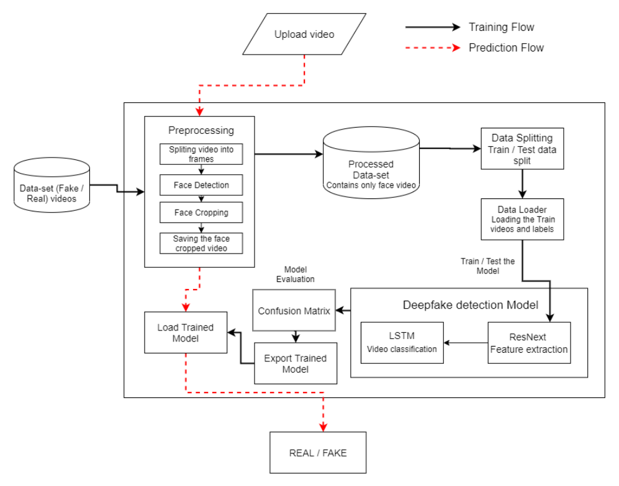
System Architecture

Slide 7
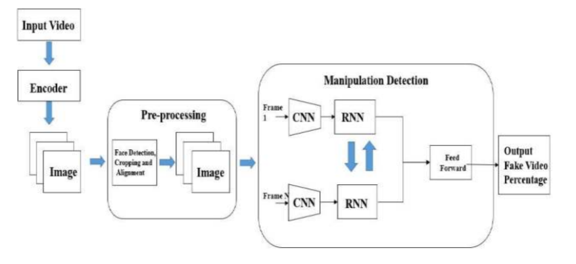
Data Flow Diagram

Slide 8
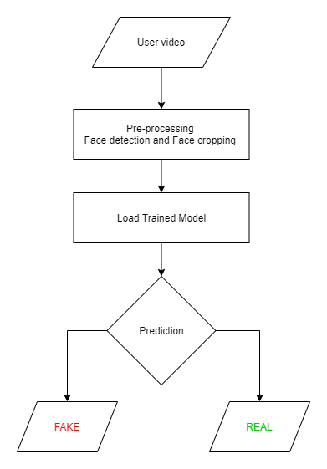
State Diagram

Slide 9
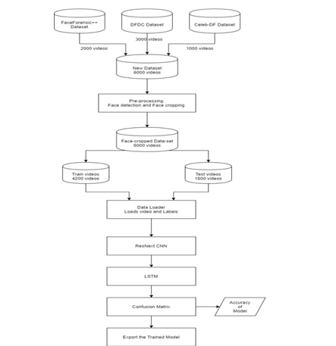
Activity Diagram

Slide 10
Tools
Face Detection:
MTCNN, dlib.
Deployment: Django.
LSTM, CNN (Deep Learning Models).
Dependencies:
CUDA (for GPU acceleration).
Hardware Requirements
Training:
GPU: NVIDIA GPU with <= 2GB RAM (for training large CNNs).
CPU: Multi-core processor (e.g., Intel i7/i9 or AMD Ryzen 7/9).
RAM: <= 16GB.
Storage: >= 256GB SSD (video datasets require significant space).

Slide 11
Module | Description | Algorithms / Pseudocode
1. Video Preprocessing | Extracts frames, resizes images, converts formats, and applies face alignment for consistency. | Pseudocode: for video in dataset: frames = extract_frames(video) for frame in frames: face = detect_face(frame) aligned_face = align_face(face) save(aligned_face)
2. Face Detection & Cropping | Identifies and crops faces from video frames using CNN or Haar Cascades to reduce background noise. | Algorithm: MTCNN (Multi-task Cascaded CNN) or OpenCV Haar Cascade
3. Feature Extraction | Extracts spatial/temporal features using CNN (e.g., Xception, ResNet) or transformers (e.g., ViT, CLIP). | Algorithm: CNN-based embedding → Flatten → Feed to classifier
4. Classification / Detection | Classifies input as real or deepfake using trained deep learning models. | Algorithm: Binary classifier (Softmax/Sigmoid)
5. Multi-Modal Fusion (Optional) | Integrates audio, lip-sync, or textual data with visual features for robust detection. | Algorithm: Cross-attention based fusion using transformers
6. Explainability & Reliability | Provides heatmaps or attention maps for interpretability. Includes uncertainty scores. | Algorithm: Grad-CAM or SHAP for CNNs; Monte Carlo dropout for uncertainty
7. Evaluation & Metrics | Evaluates model performance on benchmark datasets like DFDC, FaceForensics++. | Metrics: Accuracy, AUC, Precision, Recall, F1 Score

Slide 12
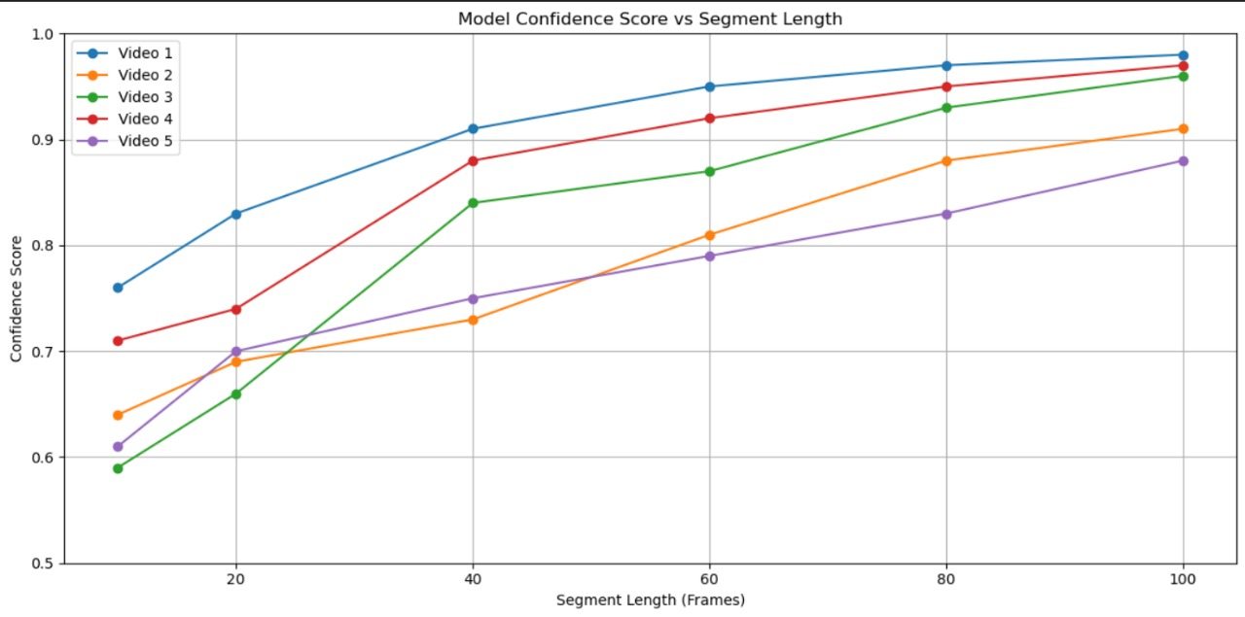
Prediction

Slide 13
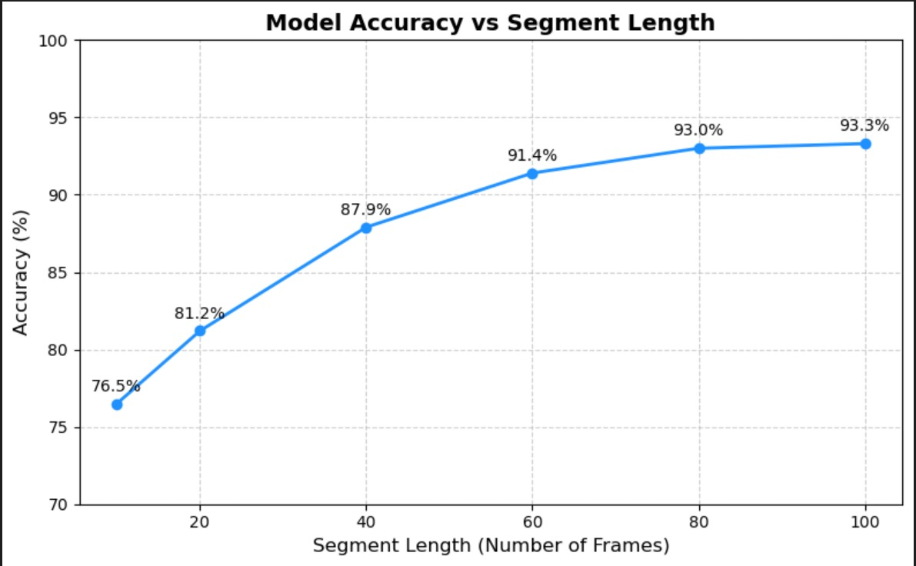
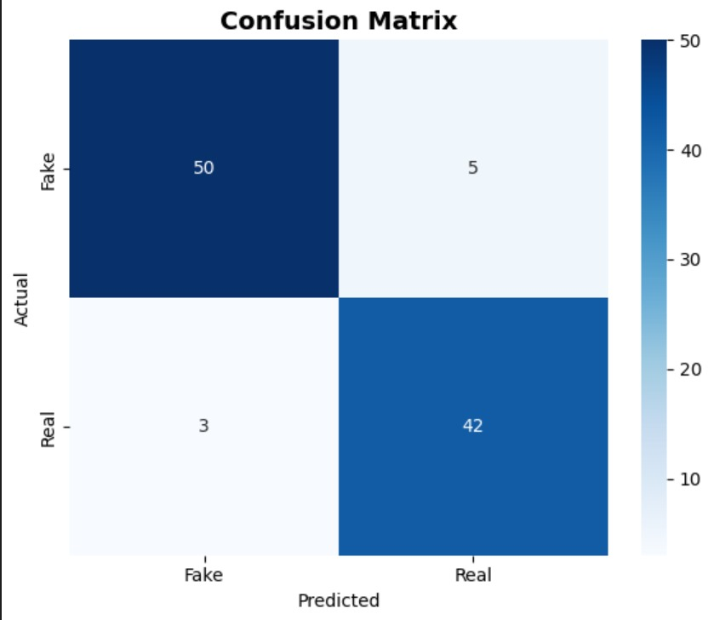
Prediction

Slide 14
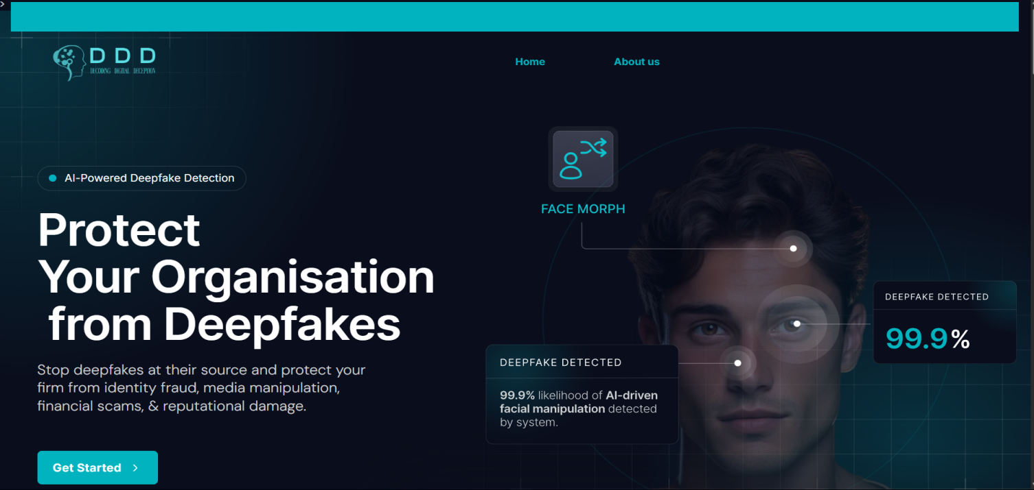
Screenshots

Slide 15
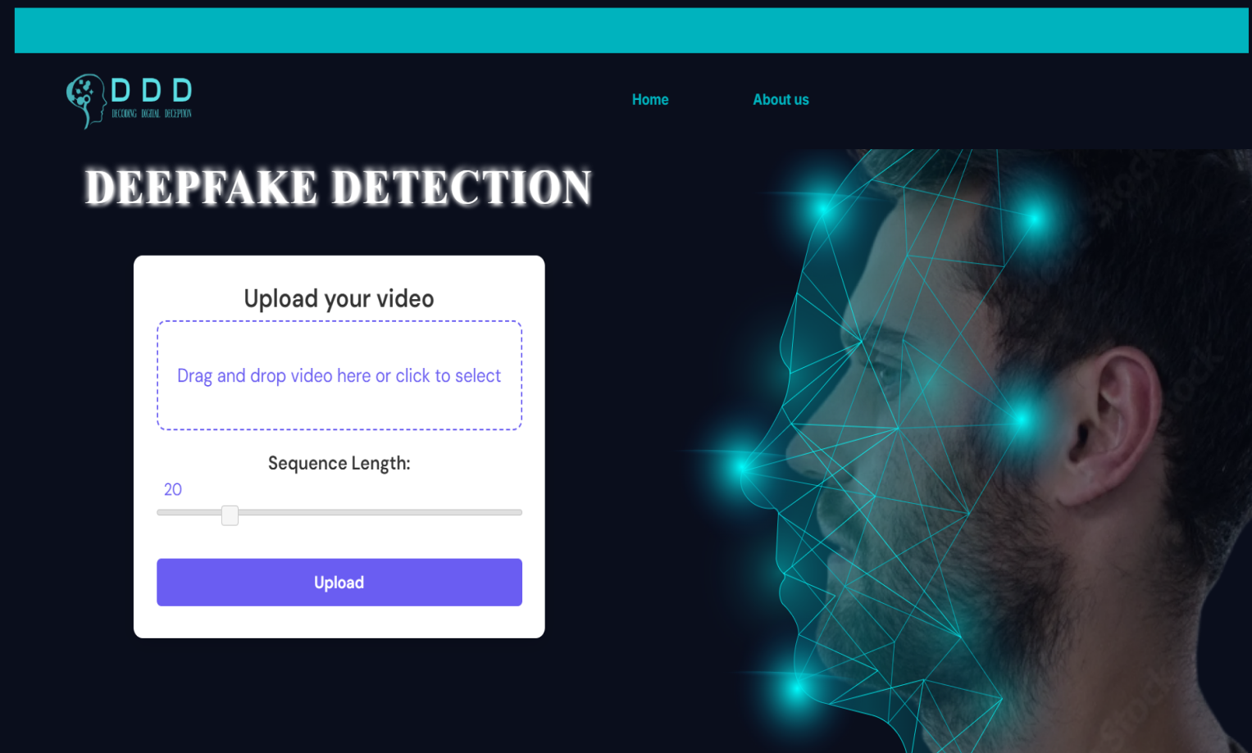

Slide 16
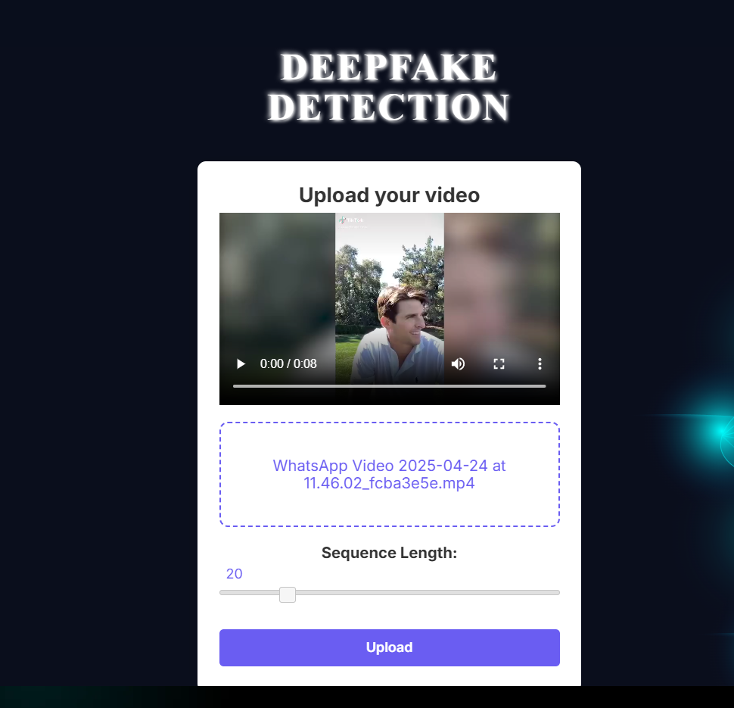

Slide 17
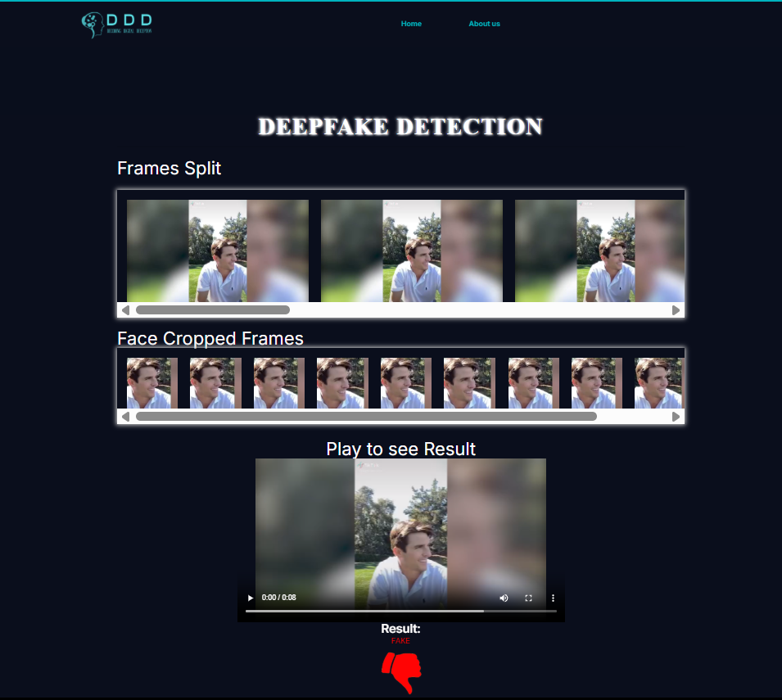

Slide 18
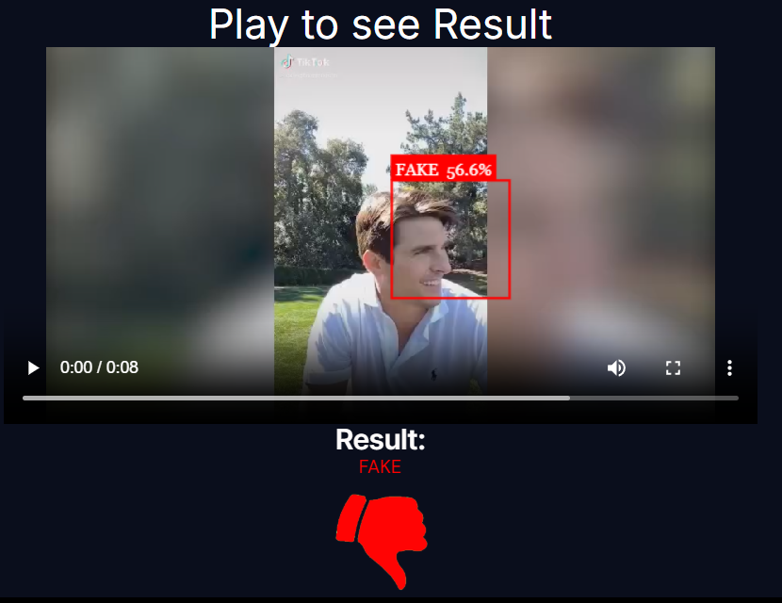

Slide 19
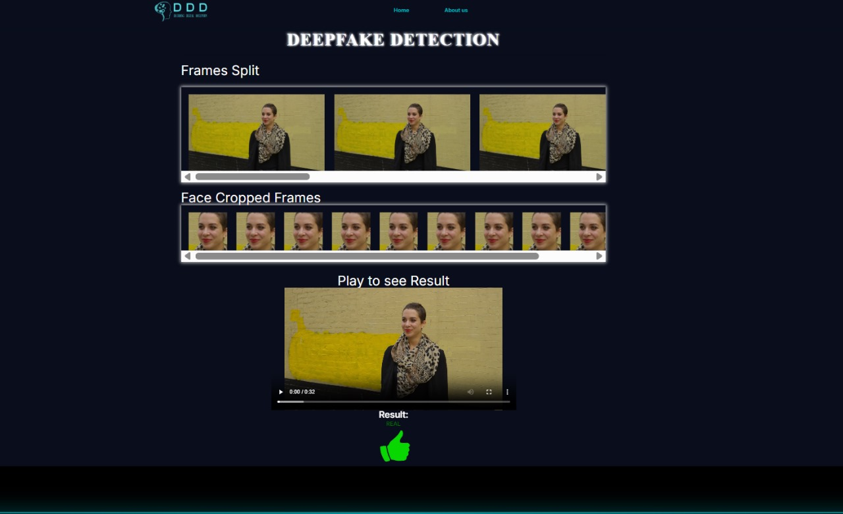

Slide 20
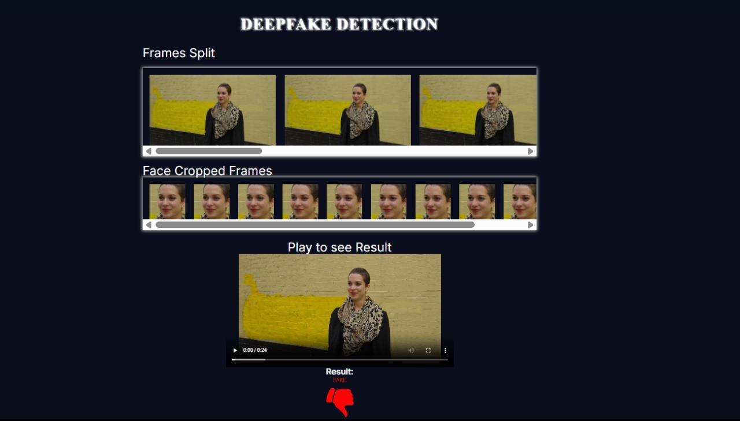

Slide 21
Bibliography
[1] Andreas Rossler, Davide Cozzolino, Luisa Verdoliva, Christian Riess, Justus
Thies,Matthias Nießner, “FaceForensics++: Learning to Detect Manipulated Facial
Images” in arXiv:1901.08971.
[2] Deepfake detection challenge dataset : https://www.kaggle.com/c/deepfake-detectionchallenge/data Accessed on 26 March, 2020
[3] Yuezun Li , Xin Yang , Pu Sun , Honggang Qi and Siwei Lyu “Celeb-DF: A
Large-scale Challenging Dataset for DeepFake Forensics” in arXiv:1909.12962
[4] Deepfake Video of Mark Zuckerberg Goes Viral on Eve of House A.I. Hearing :
https://fortune.com/2019/06/12/deepfake-mark-zuckerberg/ Accessed on 26 March,
2020
[5] 10 deepfake examples that terrified and amused the internet :
https://www.creativebloq.com/features/deepfake-examples Accessed on 26 March,
2020

Slide 22
THANK YOU

